Slide 1
Application Architecture
Describes the behaviour of applications used in a system, focused on how they interact with each other and with users.
Types of application architecture
Thick-Client architecture
Thin-Client architecture
Rich-Client architecture
One-Tier architecture
Two-Tier architecture
Three-Tier architecture

Slide 2
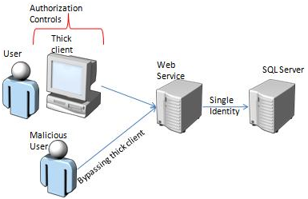
Thick Client Architecture
A computing workstation that includes most or all of the components essential for operating and executing software applications independently.
Contains most hardware resources on board to perform computation operations and to run applications.
Connected to the server through a network connection.

Slide 3
Doesn’t consume any of the server’s computing resources to execute applications.
Completes processing on client side.
Also called as Heavy, Fat architectures.
Advantages
Working offline
Better multimedia performance
More flexibility
Using existing infrastructure

Slide 4
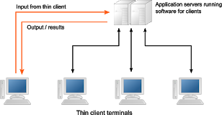
Thin-Client Architecture
A computer application that depends heavily on other client to fullfil its computational roles.
Completes processing on server side.

Slide 5
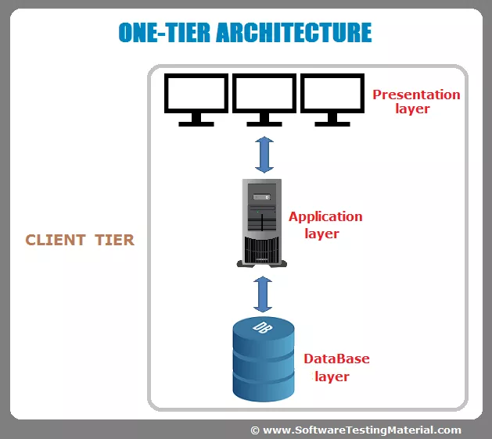
One-Tier architecture
It consists of all the layers such as presentation, Business, Data Access layers in a single software package.
Applications which handles MP3 player, MS Office are comes under one tier application.
Data is stored in the local system or a shared drive.

Slide 6
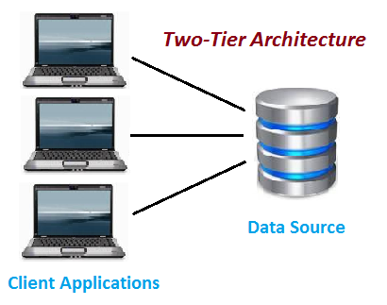
Two-Tier architecture
Basically two-tier architecture is divided into
1.Client Tier
2. Data Tier
Direct communication & runs faster.
Client system handles both presentation
and application layers.
Server system handles Database layer.

Slide 7
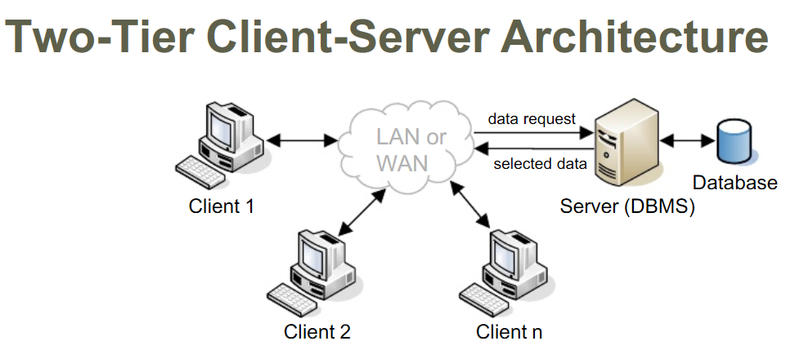

Slide 8
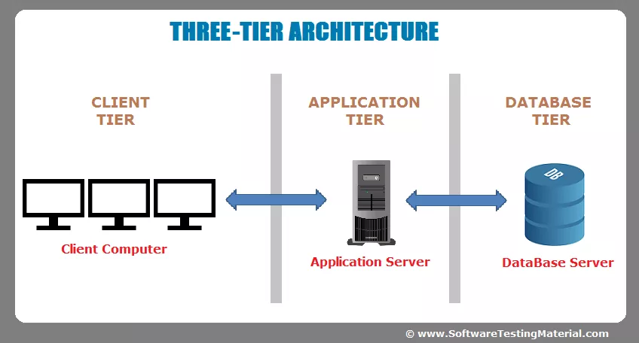
Three-Tier architecture
Basically three-tier architecture is divided into
1.Presentation Layer
2.Application Layer
3.Database Layer

Slide 9
